Slide 1
Fraction
On her biology test, Cathy answered 5/6 of the questions correctly. If Cathy answered 18 of the the first 27 questions correctly, what is the least number of questions on the test?

Slide 2
Fraction
On her biology test, Cathy answered 5/6 of the questions correctly. If Cathy answered 18 of the the first 27 questions correctly, what is the least number of questions on the test?
Cathy already missed 9 questions
Number of questions missed = 1/6 total number
1/6 total number ≥ 9
Total number ≥ 54

Slide 3


Slide 4
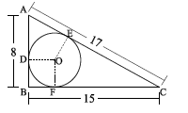
Triangle ADO and AOE identical
AE = AD = 8 – r
Triangle CEO and COF identical
CE = CF = 15 – r
AE + CE = 17
8 – r + 15 – r = 17
23 – 2r = 17
6 = 2r
r = 3

Slide 5
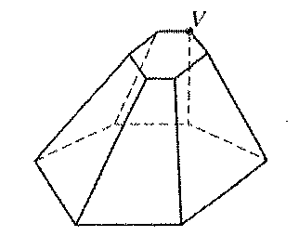
Questions of the Week (7th)
The three dimensional figure has two parallel bases
and 18 edges. Line segments are to be drawn
connecting vertex V with each of the other 11 vertices
in the figure. How many of these segments will not lie
on an edge of the figure?

Slide 6
Questions of the Week
The three dimensional figure has two parallel bases
and 18 edges. Line segments are to be drawn
connecting vertex V with each of the other 11 vertices
in the figure. How many of these segments will not lie
on an edge of the figure? 8 (11 – 3)

Slide 7
Ratio
The ratio of the number of Sam’s marbles to the number of Winston’s marbles was 8 : 3. After Sam gave 45 marbles to Winston, they had the same number of marbles. How many marbles did Sam have at first?

Slide 8
Ratio: Solution/Example 3
The ratio of the number of Sam’s marbles to the number of Winston’s marbles was 8 : 3. After Sam gave 45 marbles to Winston, they had the same number of marbles. How many marbles did Sam have at first?
Assume Sam had 8x marbles at first
Sam Winston
before 8x 3x
after 8x − 45 3x + 45
8x − 45 = 3x + 45
5x = 90
x = 18
Sam had 8x = 8•18 = 144 marbles at first.

Slide 9
Ratio: Solution/Example 3
The ratio of the number of Sam’s marbles to the number of Winston’s marbles was 8 : 3. After Sam gave 45 marbles to Winston, they had the same number of marbles. How many marbles did Sam have at first?
Assume Sam had x marbles at first
Sam Winston
before x ³/₈x
after x − 45 ³/₈x + 45
x − 45 = ³/₈x + 45
⁵/₈x = 90
x = 144
Sam had 144 marbles at first.

Slide 10
Ratio: Solution/Example 3
The ratio of the number of Sam’s marbles to the number of Winston’s marbles was 8 : 3. After Sam gave 45 marbles to Winston, they had the same number of marbles. How many marbles did Sam have at first?
Assume Sam had x marbles at first
Sam Winston
before x ³/₈x
after x − 45 ³/₈x + 45
x − 45 = ³/₈x + 45
⁵/₈x = 90
x = 144
Sam had 144 marbles at first.

Slide 11
Ratio
George and Alfred had the same number of greeting cards. After George used 6 greeting cards and Alfred used 30 greeting cards, the ratio of the number of Georges greeting cards to the number of Alfred’s greeting cards was 7 : 5. How many greeting cards did they have left?

Slide 12
Ratio: Solution/Example 5
George and Alfred had the same number of greeting cards. After George used 6 greeting cards and Alfred used 30 greeting cards, the ratio of the number of Georges greeting cards to the number of Alfred’s greeting cards was 7 : 5. How many greeting cards did they have left?
X greeting cards left
George Alfred
After ⁷/₁₂x ⁵/₁₂x
Before ⁷/₁₂x + 6 ⁵/₁₂x + 30
⁷/₁₂x + 6 = ⁵/₁₂x + 30
²/₁₂x = 24
¹/₆ x = 24
x = 144

Slide 13
Ratio: Solution/Example 5
George and Alfred had the same number of greeting cards. After George used 6 greeting cards and Alfred used 30 greeting cards, the ratio of the number of Georges greeting cards to the number of Alfred’s greeting cards was 7 : 5. How many greeting cards did they have left?
12x greeting cards left
George Alfred
After 7x 5x
Before 7x + 6 5x + 30
7x + 6 = 5x + 30
7x – 5x = 30 – 6
2x = 24
X = 12
Cards left = 12x = 12•12 = 144

Slide 14
Ratio: Solution/Example 2
Three boxes A, B and C, had 260 ping pong balls. Lisa added some ping pong balls into box A and the number of ping pong balls in box A tripled. She took out half of the ping pong balls in box B and added 40 ping pong balls into box C. The ratio of the number of ping pong balls in boxes A, B and C became 6 : 4 : 5. Find the original ratio of the number of ping pong balls in boxes A, B and C.
A B C
Current 6x 4x 5x
Original 2x 8x 5x − 40
The original total number is 260, so
2x + 8x + 5x − 40 = 260
15x = 300
X = 20
A : B : C = 2x : 8x : (5x − 40)
= 40 : 160 : 60 = 4 : 16 : 6 = 2 : 8 : 3

Slide 15
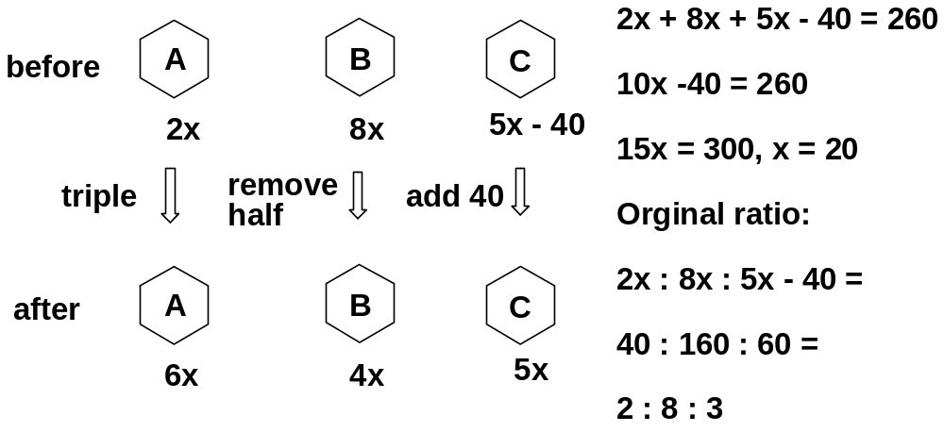
Ratio: Solution/Example 2
Three boxes A, B and C, had 260 ping pong balls. Lisa added some ping pong balls into box A and the number of ping pong balls in box A tripled. She took out half of the ping pong balls in box B and added 40 ping pong balls into box C. The ratio of the number of ping pong balls in boxes A, B and C became 6 : 4 : 5. Find the original ratio of the number of ping pong balls in boxes A, B and C.

Slide 16
Percentage: Solution/Example 3
When siblings Mik, Ike and Spike do chores around the house their parents pay them each different amounts of money. Ike always gets 20% more money than Spike, while Ike always gets 30% less money than Mike. If their parents decide to pay them $13.70 total, how much does Ike get paid?
Ike : Spike = 120 : 100 = 6 : 5 (= 42 : 35)
Ike : Mike = 70 : 100 = 7 : 10 (= 42 : 60)
Ike : Spike : Mike = 42 : 35 : 60
= 42/137 : 35/137 : 60/137
= 30% : 26% : 44%
Ike = 42/137 •13.70 = $4.2
=30% • 13.70 = $4.2

Slide 17
Percentage: Solution/Example 3
When siblings Mik, Ike and Spike do chores around the house their parents pay them each different amounts of money. Ike always gets 20% more money than Spike, while Ike always gets 30% less money than Mike. If their parents decide to pay them $13.70 total, how much does Ike get paid?

Slide 18
Percentage: Solution/Example 3
When siblings Mik, Ike and Spike do chores around the house their parents pay them each different amounts of money. Ike always gets 20% more money than Spike, while Ike always gets 30% less money than Mike. If their parents decide to pay them $13.70 total, how much does Ike get paid?
Ike : Spike = 120 : 100 = 6 : 5 (= 42 : 35)
Ike : Mike = 70 : 100 = 7 : 10 (= 42 : 60)
Ike : Spike : Mike = 42 : 35 : 60
= 42/137 : 35/137 : 60/137
= 30% : 26% : 44%
Ike = 42/137 •13.70 = $4.2
=30% • 13.70 = $4.2

Slide 19
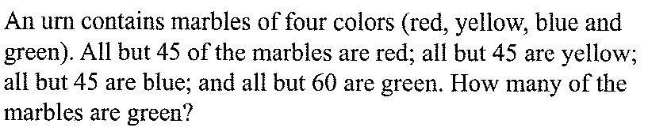
7th

Slide 20
7th
T = red + yellow + blue + green
T = 45 + red
T = 45 + yellow
T = 45 + blue
T = 60 + green
4T = 195 + T
3T = 195
T = 65
Green = 65 – 60 = 5

Slide 21
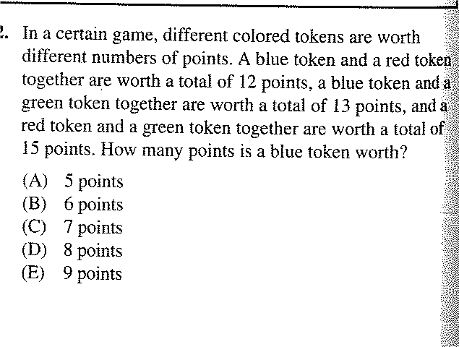

Slide 22
B + R = 12
B + G = 13
R + G = 15
B = ?
2B + 2G + 2R = 40
B + G + R = 20
B + 15 = 20
B = 5 (A)

Slide 23
Speed: Example 8
Marco’ speed riding up a hill is 40% of his speed down the hill. It takes him 2 hours longer to ride up the hill than it takes him to ride down the hill. How long, in hours, does it take him to ride down the hill? Express your answer as a common fraction.

Slide 24
Speed: Solution/Example 8
Marco’ speed riding up a hill is 40% of his speed down the hill. It takes him 2 hours longer to ride up the hill than it takes him to ride down the hill. How long, in hours, does it take him to ride down the hill? Express your answer as a common fraction.
time speed distance
Downhill x (h) y xy
Uphill x + 2 40%y = 0.4y (x+2)•0.4y
xy = (x + 2)•0.4y
X = (x + 2)•0.4
10x = (x + 2)4
10x = 4x + 8
6x = 8
x = 8/6 = 4/3 h

Slide 25
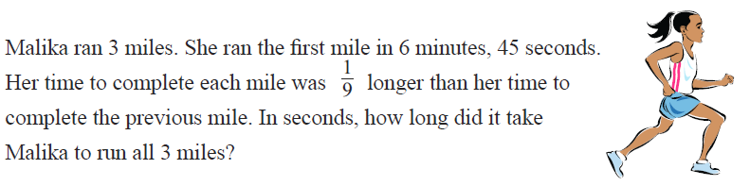

Slide 26
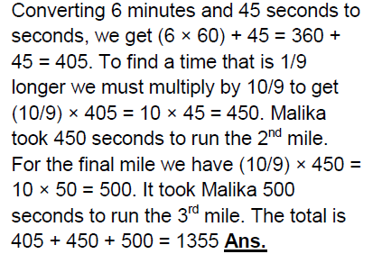

Slide 27
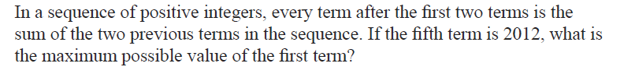

Slide 28
X, y, x+y, x+2y, 2x+3y
2x+3y = 2012
X: max; y: min
y=1, x is not an integer
Y=2, x = 1003

Slide 29
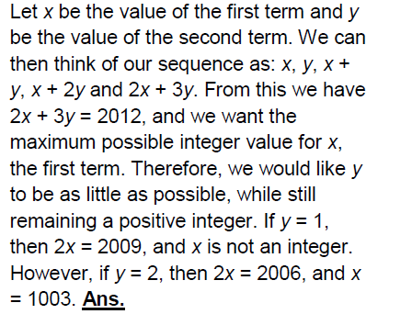

Slide 30
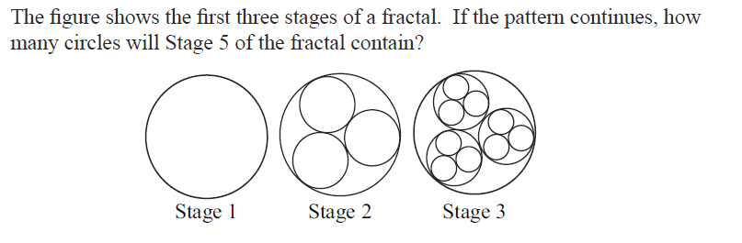

Slide 31
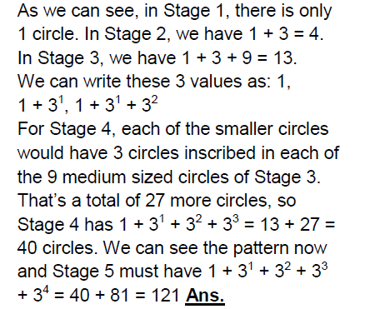

Slide 32
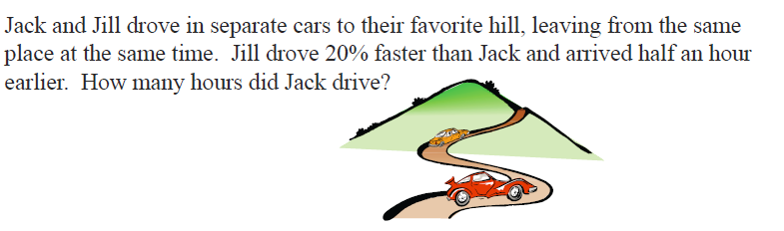

Slide 33
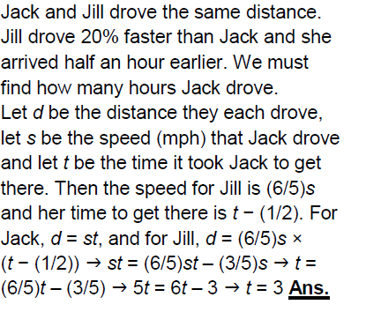

Slide 35

